Slide 1
The strategy pattern

Slide 2
Introduction
The observer method is a Behavioral design Pattern which allows you to define or create a subscription mechanism to send the notification to the multiple objects about any new event that happens to the object that they are observing. The subject is basically observed by multiple objects. The subject needs to be monitored and whenever there is a change in the subject, the observers are being notified about the change. This pattern defines one to Many dependencies between objects so that one object changes state, all of its dependents are notified and updated automatically.
Notes:
This is a straightforward solution for calculating the average of 2 numbers.
Notice the code in lines 3-5, repeated in lines 7-9.

Slide 3
Problem Without using Observer Method
Imagine you want to create a calculator application that has different features such as addition, subtraction, changing base of the numbers to hexadecimal, decimal, and many other features. But one of your friends is interested in changing the base of his favorite number to Octal base number and you are still developing the application. So, what could be the solution to it? Should your friend check the application daily just to get to know about the status? But don’t you think it would result in a lot of unnecessary visits to the application which were definitely not required. Or you may think about that each time you add the new feature and send the notification to each user. Is it OK? Sometimes yes but not every time. Might be some users get offended by a lot of unnecessary notifications which they really don’t want.
Notes:
This is a straight forward solution for calculating the average of 10 numbers.
Notice now the code in lines 4-6 repeated more than once (3 times to be exact).
In real life, the size of data that programs deal with, is generally huge.
For example:
Bank system calculations
Seeking information on the web.
Image processing
Network traffic monitoring
etc…
It would be impractical to repeat the same few commands dozens, or hundreds or thousands of times.
Programs would become unreadable, error-prone and hard to fix.
There must be another solution for the repetition-of-similar-or-same-code problem!

Slide 4
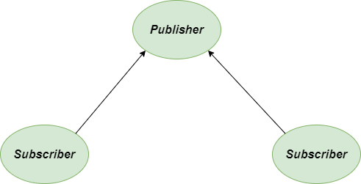
Solution using Observer Method
Let’s discuss the solution to the above-described problem. Here comes the object Subject into the limelight. But it also notifies the other objects also that’s why we generally call it Publisher.
All the objects that want to track changes in the publisher’s state are called subscribers.

Slide 6
class Subject: """Represents what is being observed""" def __init__(self): """create an empty observer list""" self._observers = [] def notify(self, modifier=None): """Alert the observers""" for observer in self._observers: if modifier != observer: observer.update(self) def attach(self, observer): """If the observer is not in the list, append it into the list""" if observer not in self._observers: self._observers.append(observer) def detach(self, observer): """Remove the observer from the observer list""" try: self._observers.remove(observer) except ValueError: pass
class Data(Subject): """monitor the object""" def __init__(self, name=''): Subject.__init__(self) self.name = name self._data = 0 @property def data(self): return self._data @data.setter def data(self, value): self._data = value self.notify() class HexViewer: """updates the Hexviewer""" def update(self, subject): print('HexViewer: Subject {} has data 0x{:x}'.format(subject.name, subject.data)) class OctalViewer: """updates the Octal viewer""" def update(self, subject): print('OctalViewer: Subject' + str(subject.name) + 'has data ' + str(oct(subject.data))) class DecimalViewer: """updates the Decimal viewer""" def update(self, subject): print('DecimalViewer: Subject % s has data % d' % (subject.name, subject.data))
Notes:
A loop is a mechanism for defining the repetition of a code segment.
Each repetition is called an Iteration.
In this chapter we will learn about the following loop types:
The while loop
The for loop
These are not the only loop types in Python, but they are very common in most programming languages.

Slide 7
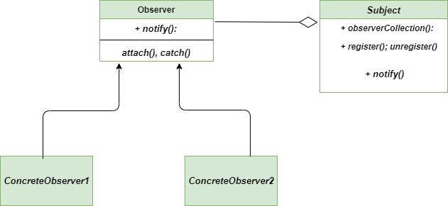
Class Diagram
Following is the class diagram for the Observer Method
Output:
DecimalViewer: Subject Data 1 has data 10
HexViewer: Subject Data 1 has data 0xa
OctalViewer: SubjectData 1has data 0o12
DecimalViewer: Subject Data 2 has data 15
HexViewer: Subject Data 2 has data 0xf
OctalViewer: SubjectData 2has data 0o17
Notes:
The while keyword indicates the use of the while loop.
A condition is checked.
If the condition evaluates to true, a block of commands (enclosed in braces) is executed.
When the program is done executing the block, the condition is checked again.
The block will be executed again and again, as long as the condition
evaluates to true.
As soon as the condition turns to false the block is skipped.

Slide 8
Additional information
Cohesion and coupling: write BETTER PYTHON CODE Part 1
https://www.youtube.com/watch?v=oNalXg67XEE
Cohesion & Coupling in Python
An Explanation of the Two Important Quality Metrics in OOP
https://www.geeksforgeeks.org/observer-method-python-design-patterns/
Notes:
Notice that
the loop block (lines 3-5) contains only program-related commands and no loop-related command. This way, we won’t accidentally omit to increment the counter or perform any other loop-related statements.
"i" is initialized in the loop header (line 2). Therefore it does not need to be initialized in a declaration.
In that case, i will be unrecognized when used outside the loop
(compile-time error).
Q: Why does result need to initialized upon declaration (line 6)?

